Slide 1
Threading & Multitasking Module 7
Operating Systems

Slide 2
Multitasking
A utility reads records from a tape
Process them and writes them into a disk one by one
Begin
OSLecture;
while Not EOF do
Read a record;
Process record;
Write a record;
End while
End
Assume, round robin scheduling with time slice of 25ms
Process will be blocked immediately due to read system call
Utilizes a small fraction of time slice
When record is read, the process become ready and then it is dispatched
Block again due to write system call and so on

Slide 3
Multitasking
An improvement to above is to define two tasks within same process
Begin
OSLecture;
while not EOF do
Task-0-Begin
Read a record;
Process a record;
Task-0-End
Task-1-Begin
Write a record;
Task-1-End
End while
End
Advantage
Subtask can run concurrently within the same process
The complier recognizes as different tasks and maintain their different identities

Slide 4
Multitasking
An application that creates photo thumbnails from a collection of images may use a separate thread to generate a thumbnail from each separate image.
• A web browser might have one thread display images or text while another thread retrieves data from the network.
• A word processor may have a thread for displaying graphics, another thread for responding to keystrokes from the user, and a third thread for performing spelling and grammar checking in the background

Slide 5
Multitasking
When process starts, the OS creates process control block (PCB)
Now, in addition to PCB, it also creates task control block (TCB) for each task within a process
A TCB needs to have save area for each task
A task also could have priorities and states
If process time slice is not over but the current task is either over or blocked
The OS chooses the next highest priority ready task within same process and schedules it
If no task is ready in the same process the process will be blocked and OS will schedules a task from some other process
This reduces the overheads of context switching at process level
The context switching at task level is far less time consuming e.g.
Also it shares the same address space and resources of process
Some OS called it multitasking and some call it multithreading
OS/2 use the concept name as multithreading

Slide 6
Threads
A thread is subdivision of work within a process
It is a basic unit of CPU utilization
It is also called a light-weight process (LWP)
Threads are like little mini processes
It may consist of;
Program counter
Register set
Stack space
A threads shares with its peer threads its
Code section
Data section
Operating system resources

Slide 7
Motivation for Threading
Most modern applications are multithreaded
Threads run within application
Multiple tasks with the application can be implemented by separate threads
Update display
Fetch data
Spell checking
Answer a network request
Process creation is heavy-weight while thread creation is light-weight
Can simplify code, increase efficiency
Kernels are generally multithreaded

Slide 8
Threads
Thread idea is used for higher throughput and better performance
Threads are cheaper in terms of system overheads
Avoid context switching of processes if thread switch is used
Each thread run sequentially
Thread can create child threads
If thread is blocked, another thread within same process can run
A traditional or heavyweight process is equal to a task with one thread
Threads provide a mechanism to achieve parallelism
Threads are very important in the design of distributed and client server systems

Slide 9
Threads
In some systems, threads are supported by the operating system
Some database management systems provide their own thread management
Some languages, like Java, provide direct support for writing the thread-based programs

Slide 10
Benefits of Multithreading
Responsiveness
It allows to run a program even if some part of it is in block state
Resource sharing
threads share resources of process, easier than shared memory or message passing
Economy
Overheads of context switching of TCB are much lesser than of PCB
Scalability
Utilization of multiprocessor or multicore architecture
Due to threading a single program can run on different processors at same time

Slide 11
Single and Multithreaded Processes

Slide 12
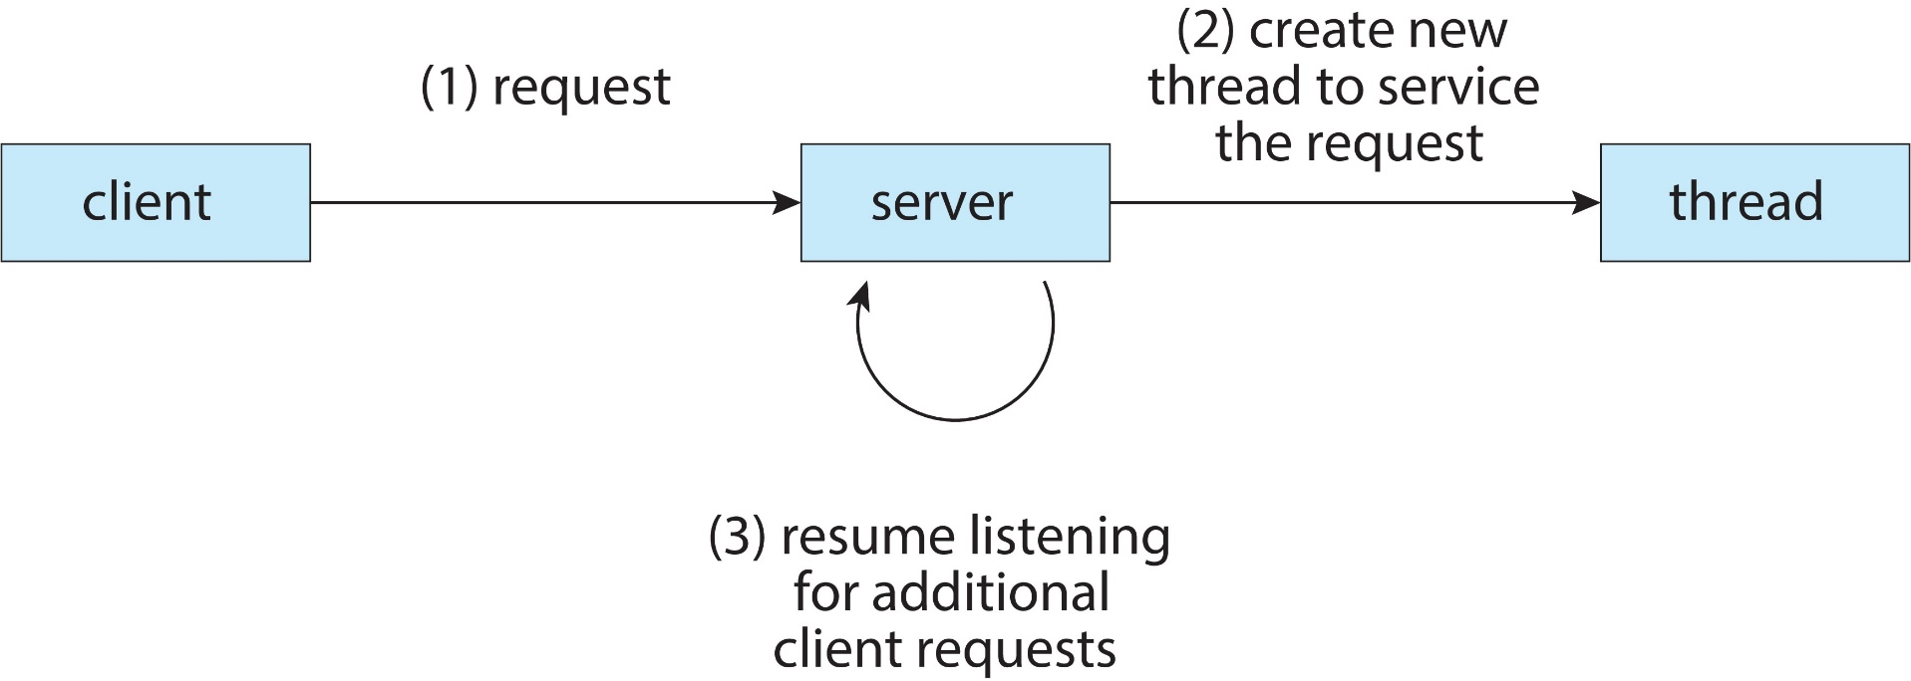
Multithreaded Server Architecture

Slide 13
Types of Threads and Multithreading Models

Slide 14
Types of Threads
There are two types of threads i.e. kernel threads and user level threads
Kernel threads
Theses are supported directly by operating system
The kernel perform thread creation, scheduling and management
Examples – virtually all general-purpose operating systems, including:
Windows
Solaris
Unix
Linux
Mac OS
Android
iOS

Slide 15
Types of Threads
User threads
These are supported above the kernel, via a set of library calls at the user level
Library provides support for thread creation, scheduling and management with no support from kernel
Example user-threads
POSIX P thread
Java threads
Hybrid approach implements both user-level and kernel supported threads

Slide 16
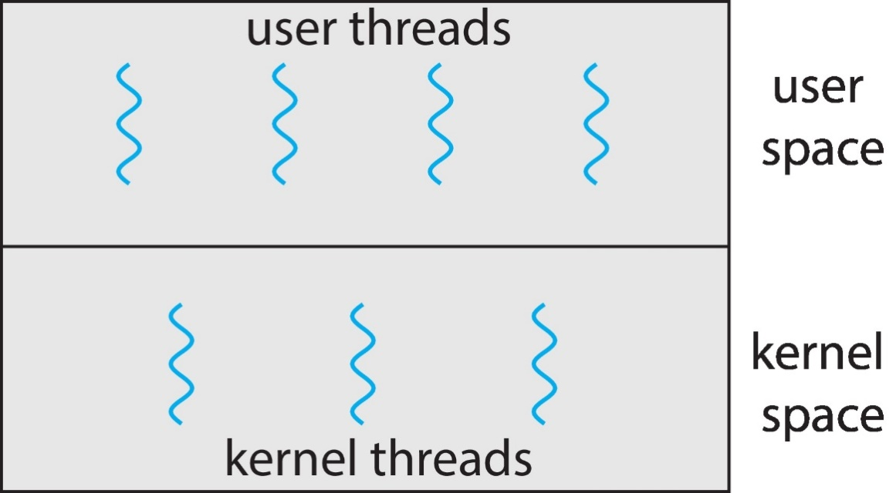
User and Kernel Threads

